Slide 1
Auto-Logger Sponsored by Florida Solar Energy Center
Group #13
Hassan Siddiqui (EE)
Zachary Ross (EE)
Justin Wright (EE)

Slide 2
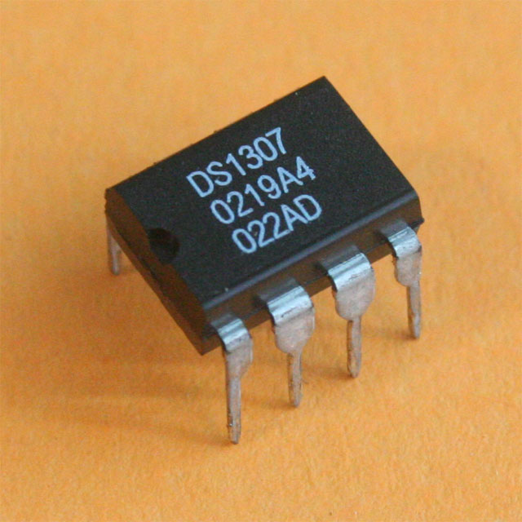
Real Time Clock DS1307
DS1307 was chosen as the RTC because of compatibility with ATmega2560
DS1307 runs in LPM while the car is off
Helps keep track of time parked and time stamps data logs

Slide 3
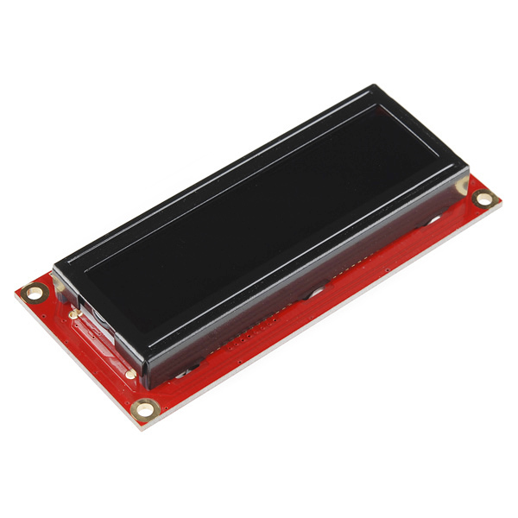
SparkFun Serial Enabled 16x2 LCD
Runs on 3.3V compatible with ATmega2560
Can use 9600 baud rate
Uses 3 wires serial to connect to ATmega2560
Used to show data collected from OBD-II and successful data transfer
Only used for Senior Design because FSEC does not want interaction between the device and user.

Slide 4
Project Overview
Vehicle interface for characteristics transportation data capture
Engine load and fuel combustion rates
Time spent and location on campus
Battery health and charge capacity
Compatible with both Internal Combustion Engine and Electric Vehicles
Wireless Communication with database
Minimal User Interface required
Autonomous functionality

Slide 5
Project Goals
Low Power design
Minimal/Non-invasive package
Robust vehicle compatibility
High reliability
Resistant to temperature fluctuations
Autonomous data logging and transmission

Slide 6
Project Specifications
Powered by 12V Lead-Acid car battery
Compatible with various vehicle makes and models
Internal Combustion Engines (ICEs) produced after 1996
Electric Nissan LEAF provided by FSEC
10cm x 10cm x 20cm Package Dimensions
Resistant to 50°C/hr temperature fluctuations
Per-Second data point resolution

Slide 7
Block Diagram of System

Slide 8
MCU Comparison
ATmega2560
ATmega328P
Digital I/O Ports: 54
Clock Speed: 16MHz
Analog Ports: 16
Operating Current: 50mA
Flash Memory: 248KB
Digital I/O Ports: 14
Clock Speed: 16MHz
Analog Ports: 6
Operating Current: 50mA
Flash Memory: 31.5KB

Slide 9
Wi-Fi Comparison
CC3100 MOD
ESP-12E
RX Sensitivity: -94dBm
Rx Operating Current: 53mA
UART Transmission Limit: 3 Mbps
Package Size: 20.5mm x 17.5mm
RX Sensitivity: -98dBm
Rx Operating Current: 50mA
UART Transmission Limit: 4.5 Mbps
Package Size: 24mm x 16mm

Slide 10
ESP-12E Additional Functionality
Provides various Low Power operating modes
Additional GPIO pins for custom firmware applications
Fast sleep/wake context switching
Light-Sleep Mode:
Less than 1mA operating current
300mS wake time

Slide 11
GPS Comparison
Copernicus II
FGPMMOPA6B
Tracking Sensitivity: -160dBm
Location Accuracy: ±7.6m
Power Consumption: 132mW
Update Rate: 1Hz
Operating Temperature: -40 °C to 85 °C
Dimensions: 19mm x 19mm
Tracking Sensitivity: -165dBm
Location Accuracy: ±3m
Power Consumption: 138.6mW
Update Rate: 10Hz
Operating Temperature: -40 °C to 85 °C
Dimensions: 16mm x 16mm

Slide 12
Device Schematic

Slide 13
PCB Design

Slide 14
OBD-II Interface Capabilities
Internal Combustion Engine
Electric Engine

Slide 15
OBD-II to UART Conversion Overview
Our device is compatible with most OBD-II protocols
CAN, KWP2000, ISO 9141-2, VPW, PWM, and raw CAN
Two ICs were needed to communicate

Slide 16
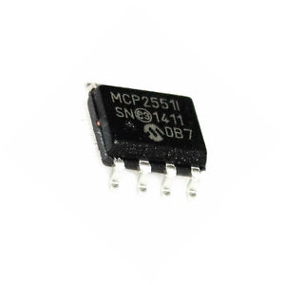
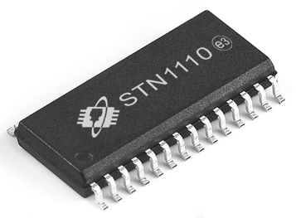
OBD-II to UART Conversion Overview
Two chips were utilized to communicate with different

Slide 17
Operating Modes
Standby – Vehicle Parked
Entire device in Low Power
MCU awakens periodically to check vehicle engine status
Wake Up – Engine Started
Vehicle localization
Location dependent startup log
Logs parking duration, date, time and location if identified as on campus

Slide 18
Operating Modes
Localization/Acquisition – Vehicle Operational
MCU identifies vehicle location
Collects or ignores data depending on current location
For privacy reasons, the Auto Logger will not continuously log transportation data
Transmission – Vehicle Parked on UCF Campus
GPS module in Low Power
Attempt to establish reliable Wi-Fi connection with database
If successful, transmit newly collected data

Slide 19
Data Storage and Reliability
Data logs will be stored on the micro SD card in a cyclical manner
For reliability reasons, the entire volume of the memory will be utilized before any logs are over-written or deleted
Logs will be populated with pertinent data gathered by the device
Logs will be formatted using the following nomenclature
“YYMMDD.hhmmss” denoting Year, Month and Day followed by the hour, minute and second the log was captured
Military time will be used to prevent confusion between AM and PM readings
Logs are stored as text files for simplicity

Slide 20
Example Mobile Data Log File name: 160607.093016.txt
Internal Combustion Engine
Electric
Vehicle Make/Model
Engine Load
Vehicle Speed
Vehicle Location
Fuel Level
Fuel Economy/Consumption
Vehicle Make/Model
Battery Health
Battery State of Charge
Vehicle cabin temperature
Atmospheric temperature
“Fuel” economy

Slide 21
Example Static Data Log File Name:
Date
Time
Location
Parking Duration

Slide 22
Power Evaluation
Lead-Acid batteries not designed to support charge depletion
Charge capacity cannot drop below 80% otherwise the battery would be irreversibly damaged
Utilize Peukert's Formula for Battery Discharge Time to estimate battery life using the worst case value of Peukert’s number (n=1.3)
$Discharge Time = \frac{Charge Capacity}{{current}^{(peukert num)}}$
$$20\% Discharge Time= \frac{45}{{0.575}^{1.3}}∗(0.2)=18.478 hours$$
Equation 1 - Lead Acid Battery Discharge Time with Peak Load
$$20\% Discharge Time= \frac{45}{{0.00056}^{1.3}}∗(0.2)=151,914 hours$$
Equation 2 - Lead Acid Battery Discharge Time with LPM Load
Component | Peak Current Draw(mA) | Low Power Current Draw (mA)
MCU | 200 | .015
Wi-Fi Module | 170 | .05
GPS Module | 75 | .015
MicroSD | 80 | .015
LCD | 50 | .015
Total | 575 | .56

Slide 23
Interpreting NMEA Sentences
Ex: $GPRMC,064951.000,A,2307.1256,N,12016.4438,E,0.03,165.48,260406,3.05,W,A*55
Desired values are Latitude and Longitude (DDmm.ssss) and Current Speed (knots)
Standard NMEA output sentences provide significantly more information than needed
Open Source libraries available for parsing of information for easy accessibility

Slide 24
GPS Module Configuration
GPS's are very sensitive to noise, so LDO regulators have been implemented to reduce noise
Module will maintain a minimum refresh rate of 1Hz so that most accurate data is available upon request by the MCU
MCU will determine if the vehicle is within the footprint of the UCF main campus. Footprint defined as:
28°36'41.3”N, 81°12'24.8''W to 28°35'33.8''N, 81°11'17.4''W
NMEA supplies current speed in knots
1 Knot = 1.15078 MPH

Slide 25
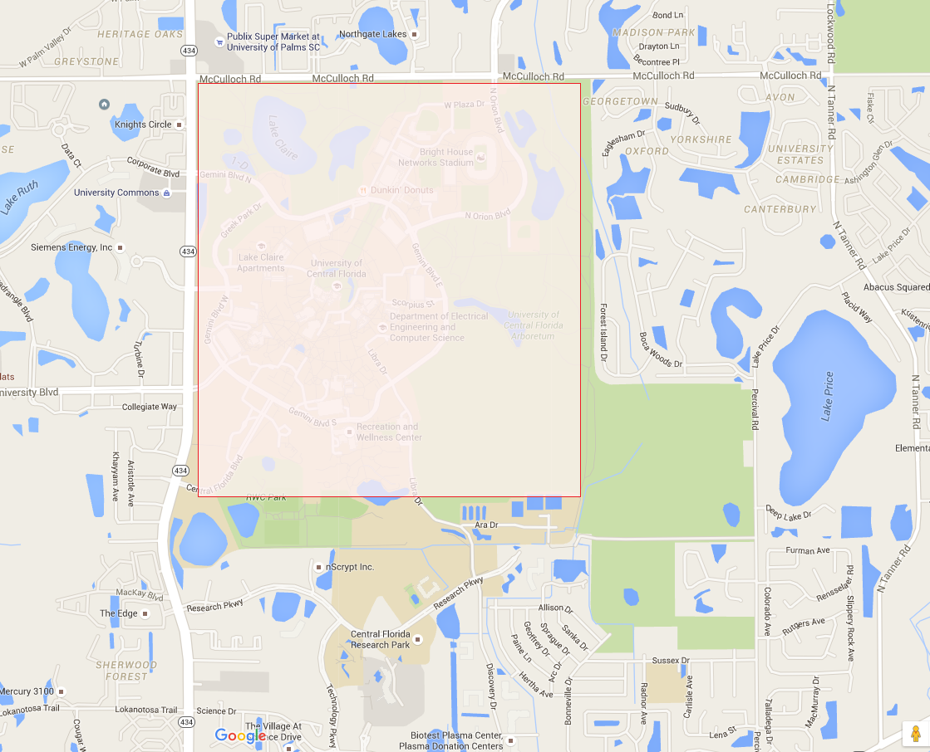
GPS Module Initiation and Boundary Region

Slide 26
Communications Overview

Slide 27
Signal Acquisition
Once the MCU identifies the vehicle as parked on campus, Wi-Fi signal acquisition will be initiated
Timeouts will be implemented to terminate the process if a connection cannot be established
Network stability will be determined through the evaluation of the received signal strength indicator (RSSI)
A signal stronger than -80dBm is sufficient for reliable file transfer

Slide 28
Serial AT Commands
The MCU will communicate with the ESP-12E via AT commands sent through a serial UART interface
Set power mode
Establish connection
Manage file transfer
Configure network characteristics

Slide 29
Useful Commands
AT+CWJAP=ssid, pwd Establish Connection
AT+CWLAP=ssid, mac, ch Returns RSSI of Network
Return string: +CWLAP:(3,"UCF_WPA2",-53,"20:cf:30:ce:60:fe",11)
AT+CIPSTART=type, addr, port Start TCP connection as client
AT+CIPSEND Send data
Successful transmission reciprocated w/ confirmation packet containing “+++”
AT+CIPSTO=time Set server timeout

Slide 30
Work Distribution
Member | Wireless Communications | Vehicle Interface | Data Management | Software | PCB Design
Hassan Siddiqui |  | Main |  |  | Secondary
Justin Wright |  |  | Main | Secondary
Zachary Ross | Main |  |  | Secondary | Secondary

Slide 31
Issues and Concerns
Wi-Fi propagation range
Efficiency of Patch on Top GPS antenna
Proprietary Vehicle Interfacing

Slide 32
Current Progress

Slide 33
Budget

Slide 34
Questions?

